Slide 1
Introduction to Python for Data Science Section 1 - Non-Specific M.Tech AIML
BITS Pilani
Pilani|Dubai|Goa|Hyderabad
Radhika B
1

Slide 2
Agenda for CS #2
Immutable & Mutable Data Structures
String & its Operations
Tuple & its Operations
List & its Operations
Set & its Operations
Dictionary & its Operations
Operators
Conditional Statements
Exception Handling

Slide 3
Immutable & Mutable Objects
Mutable Objects:
Some objects are mutable, meaning their values can change throughout the execution of a program. In practice, this means they maintain the same id even after a change in value. This is known as an ‘in-place’ change because it doesn’t require the creation of a new object to change in value. Mutable objects include lists, dictionaries, and sets.
Immutable objects:
Immutable objects on the other hand can not change in value during the execution of a program. The only way to alter the value of a variable that points to an immutable object, is to create an entirely new object containing the altered value. In other words, immutable objects can not be changed ‘in-place.’ Numbers, String, tuples are examples.

Slide 4
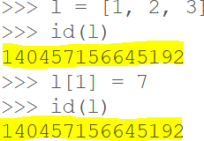
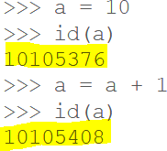
Immutable & Mutable
Mutable Structures
Immutable Structures
As you can see above, once the value of integer a is modified, so is it’s id, because it now points to a different object and a different space in memory. Immutable objects in python include numbers (integers and floats), strings, bools, tuples, and more.
As you can see above, even though the
contents of List l is modified, it’s id
in
remains the same. Mutable objects
python include lists, sets, dictionaries.

Slide 5
Demo on Python Data Types / Structures
Lets have a hands-on session on :
String & its operations
Tuple & its operations
List & its operations
Set & its operations
Dictionary & its operations

Slide 6
Operators in Python
Python language supports the following types of operators:
Arithmetic Operators
Comparison (Relational) Operators
Assignment Operators
Logical Operators
Bitwise Operators
Membership Operators
Identity Operators

Slide 7
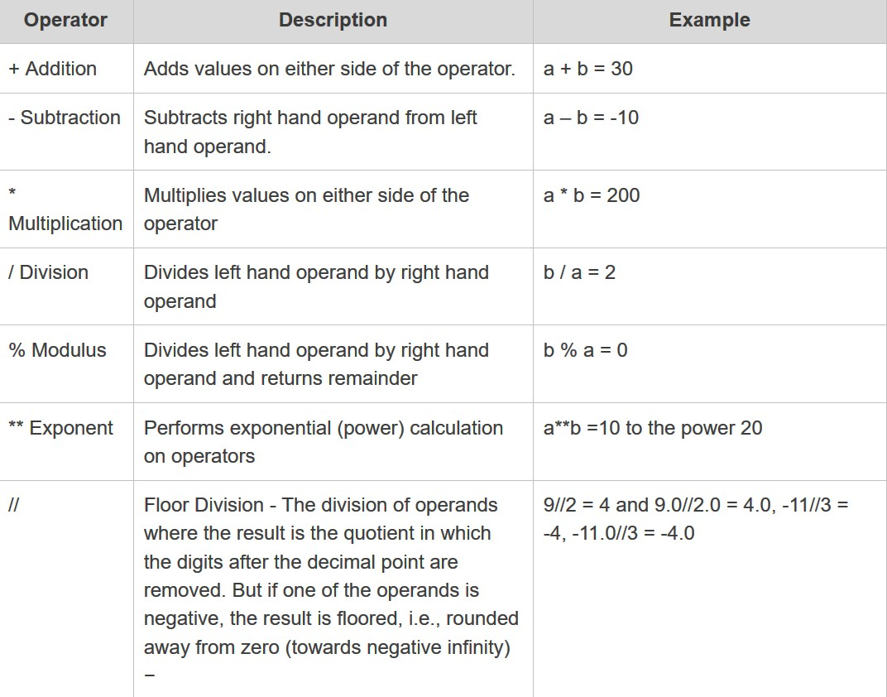
Arithmetic Operators
Assume a=10 b=20

Slide 8
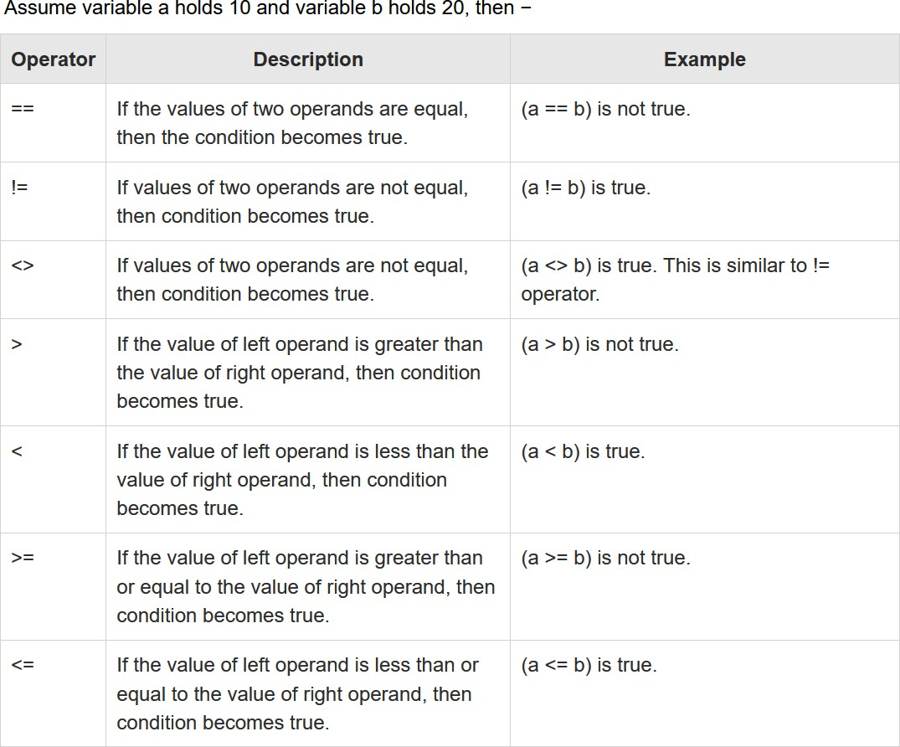
Comparison (Relational) Operators

Slide 9
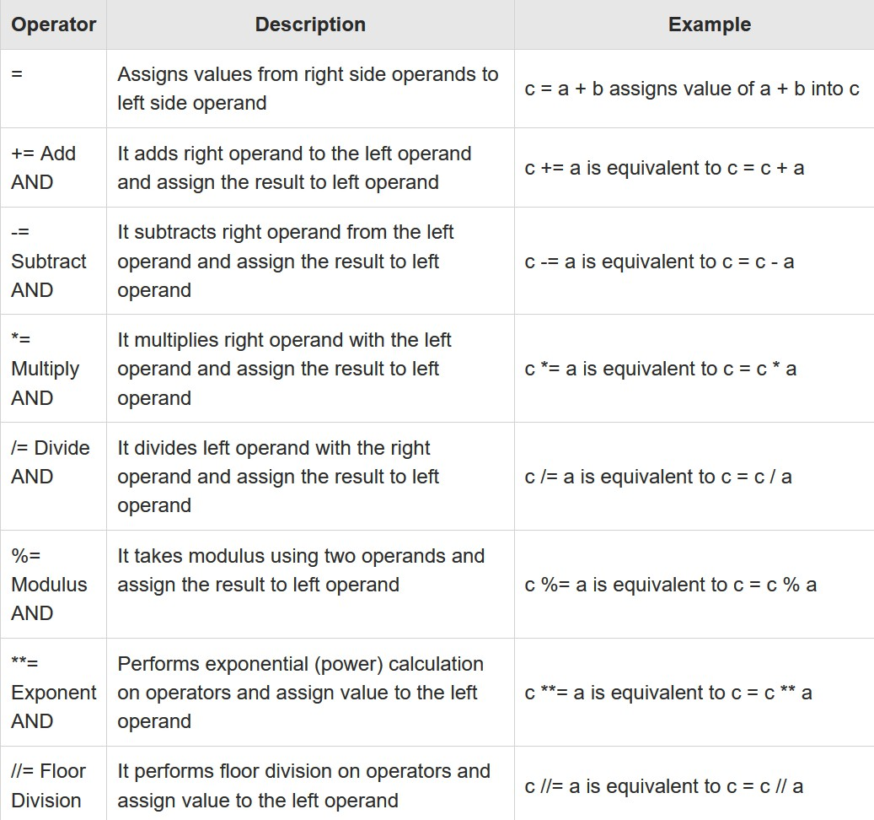
Assignment Operators

Slide 10
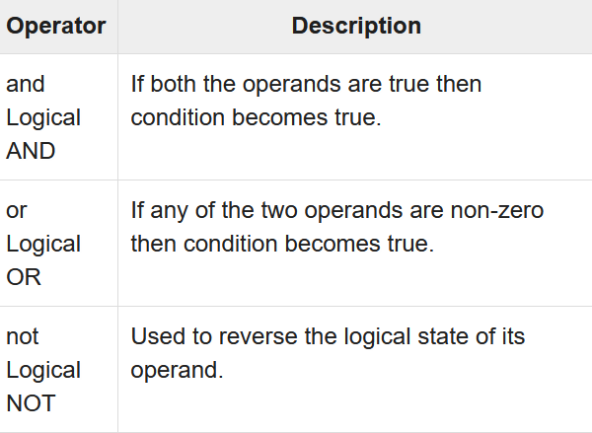
Logical Operators

Slide 11
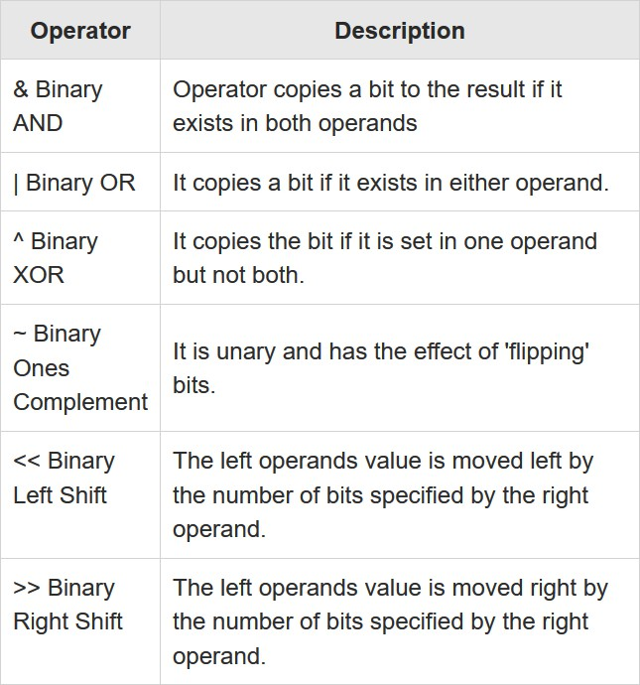
Bitwise Operators

Slide 12
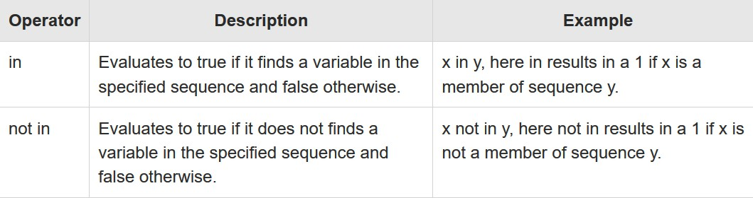
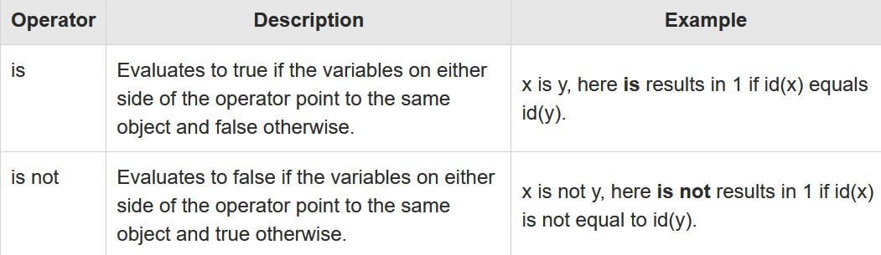
Membership & Identity Operators
Python’s membership operators test for membership in a sequence, such as strings, lists, or tuples:
Identity operators compare the memory locations of two objects.

Slide 13
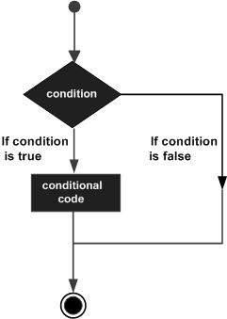
Conditional Execution in Python (Decision Making)
Decision making is anticipation of conditions occurring while execution of the program and specifying actions taken according to the conditions.
Decision structures evaluate multiple expressions which produce TRUE or FALSE as outcome. You need to determine which action to take and which statements to execute if outcome is TRUE or FALSE otherwise.
Following is the general form of a typical decision making structure found in most of the programming languages −
Python programming language assumes any non-zero and non-null values as TRUE, and if it is either zero or null, then it is assumed as FALSE value.

Slide 14
Decision Making in Python
Python Supports the following:
If statements
If … else statements
Nested If statements
Chained If statements
if expression: statement(s)
Statement after if condition
if expression: statement(s)
else:
statement(s)
Statement after if condition
if expression1:
statement(s) else:
if expression2: statement(s)
else:
if expression1: statement(s)
elif expression2: statement(s)
else:
statement(s)
statement(s)

Slide 15
Exception Handling
The Exception Handling in Python is one of the powerful mechanism to handle the runtime errors so that normal flow of the application can be maintained and user friendly error messages can be displayed.
The try block lets us test a block of code for errors.
The except block lets us handle the error.
The finally block lets us execute code, regardless of the result of the try and except blocks.
try:
a = 1/0
except Exception as e: print(e)
finally:
print(“I am always there”)

Slide 16

Post your queries in the Discussion Forum!!

Slide 17






Feedback
: 5
: 3
Thank You for your time & attention !
Contact: radhika.richy@wilp.bits-pilani.ac.in
: 1

